Slide 1


Recommendations for health system reform in Georgia
Dr Lajos Kovács
PAR Project
March 2021

Slide 2
Health System Reform - Novel Solutions
Strengthen governance – Public Administration Reform
Ensure adequate and sustainable funding and improve efficiency of health financing – Capitation + Result-based component in Primary Health Care, Result-based financing (DRGs/tariffs) in hospital financing, Strategic purchasing
Build up human capital – Qualification Standards for Health Professionals, and Continuous Professional Development
Develop efficient pricing system and ensure supply of high quality, effective and safe medicines – National Drug Policy / New Law
Extend digitalization and e-health records and develop health management information system
Strengthen health care delivery system and improve quality of health care services – PHC Gatekeeping, Health Care Accreditation System
Ensure effective public health services – Post-COVID-19 strategies

Slide 3
Health System Reform
vs.
Health System Strengthening
Phase I -> Health Service Delivery
Step 1: PHC -> access
Step 2: guidelines, standards, protocols
-> effectiveness
Step 3: DRG -> efficiency
Step 4: accreditation -> quality
Purchaser
Phase II - > Social Health Protection
Steps: social health insurance -> equity
Equity
Coverage
Efficiency
Strategic purchasing
Contribution / Taxes
Contract / Financing
UHC
PHC / Gatekeeping
Effectiveness
Population
Health service delivery
Access
Quality

Slide 4
Recommendations for Health System Reform
 | Level 1 | Level 2 | Level 3
Revenue | taxes | mandatory insurance contribution paid by employer and employee | voluntary insurance contribution paid by employer and employee
Purchaser | government agency or national health insurance fund | national health insurance fund and private insurance companies | national health insurance fund and private insurance companies
Benefits | emergency care, preventive care, treatment of certain diseases, transportation | in-patient and out-patient care, laboratory services and prescription drugs | individual package of services (health and comfort services)
Coverage | citizens of Georgia | citizens of Georgia and foreign citizens permanently residing in Georgia who contribute to the mandatory health insurance system | citizens of Georgia and foreign citizens permanently residing in Georgia who contribute to the voluntary health insurance system
Provider | public and private health care providers | public and private health care providers | public and private health care providers

Slide 5
Social Health Authority
Design & integration of schemes
Elaboration of guidelines and tools
Collaboration with other stakeholders
Stewardship
Financial Management
Social Service Delivery
Purchasing
Technical Support
Administration
Quality Management
Monitoring & Evaluation
Revenue collection & pooling
Assessment & evaluation
Analysis for adjustment of policies
Pooling and transfers of contributions
Surveys system
Quality assurance mechanisms
Fund/account management
Accounting
Transfers to providers
Training and coaching (technical and operational)
Coaching in facilities
Social health assistance
Hotline/communication
Contracting
Adjustment Payment mechanism
Payment
Supervision/monitoring
Databases/Statistics
Monitoring

Slide 6
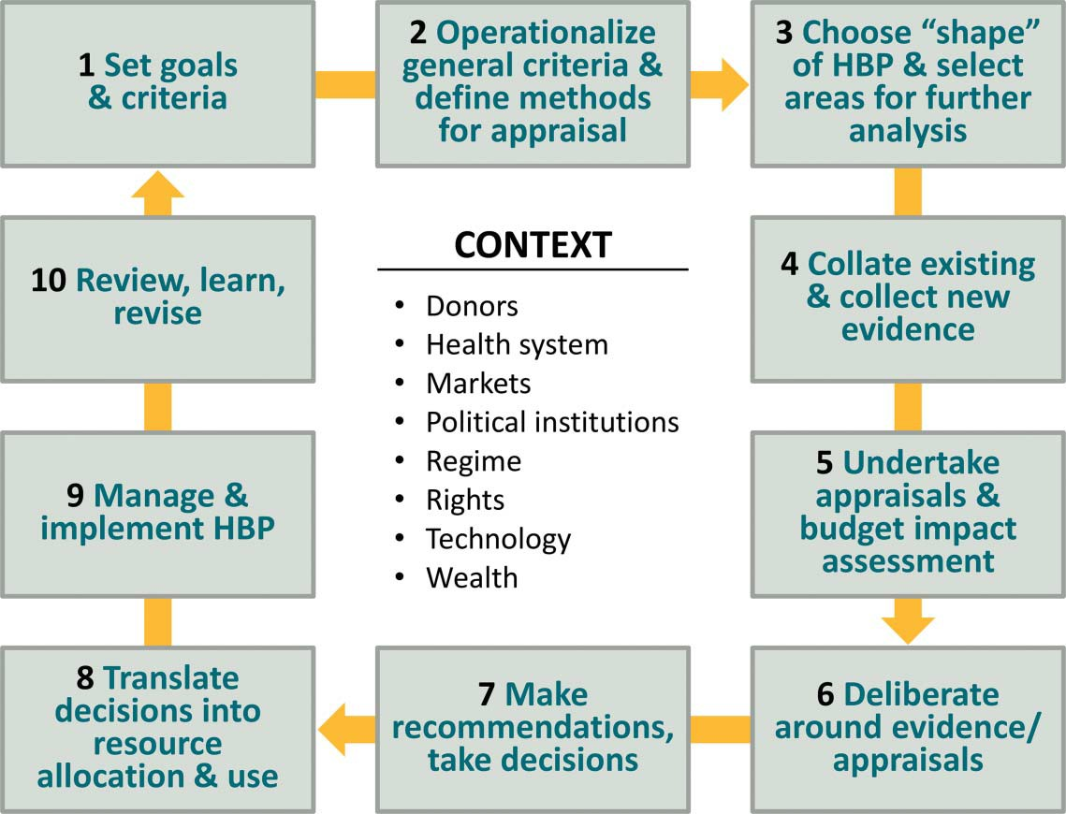
How to Set Health Benefit Package?
Source: A Glassman, U Giedion, Y Sakuma, PC Smith

Slide 7
Statement of benefit package gives rise to other benefits:
It creates explicit entitlements for patients.
It facilitates resource allocation decisions, creating a precondition for reducing variations in care and outcomes.
It facilitates orderly adherence to budget limits, which might otherwise be attained only though arbitrary restrictions.
It reduces the risk that providers will require informal payments from patients to secure access to high-value services.
The entitlements empower poor and marginalized groups.

Slide 8
Quality of Health Services
the degree to which consumers progress toward a desired outcome
when carrying out interventions correctly according to pre-established standards and procedures, with an aim of satisfying the customers of the health system and maximizing results without generating health risks or unnecessary costs.
the level of excellence produced and documented in the process of patient care, based on the best knowledge available and achievable at a particular facility.
approaches to quality: Quality Control (QC); Total Quality Management (TQM); Quality Assurance (QA); Continuous Quality Improvement (CQI); Healthcare Accreditation (HA)

Slide 9
Requirements for quality improvement
Adequate funds are needed to finance benefit packages
Strategic purchasing of health services is needed to provide sufficient funds and incentives for providers
Performance based financing needs to reflect quality and safety
Autonomous hospitals and hospital management may improve efficiency and quality
Promote/Incentivize health care accreditation
Establishment of credible accountability mechanism

Slide 10
What is Healthcare Accreditation?
Mechanisms for recognition of institutional competence
By an independent accrediting body
Applying standards for optimal and achievable performance
Emphasis on continuous quality improvement
Provider survey by external peer reviewers

Slide 11
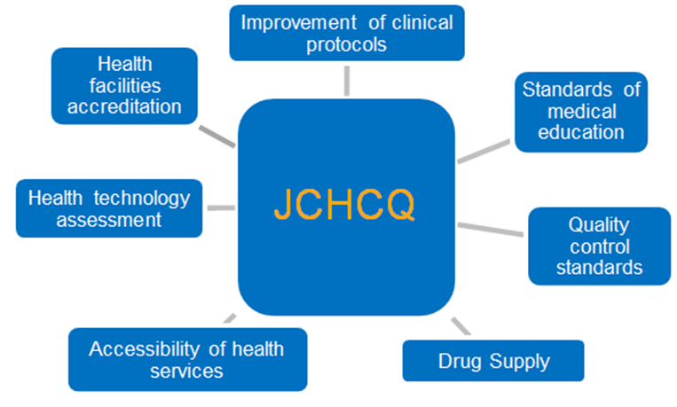
How to Administer Healthcare Quality?

Slide 12
Thank you for your attention!

